Slide 1
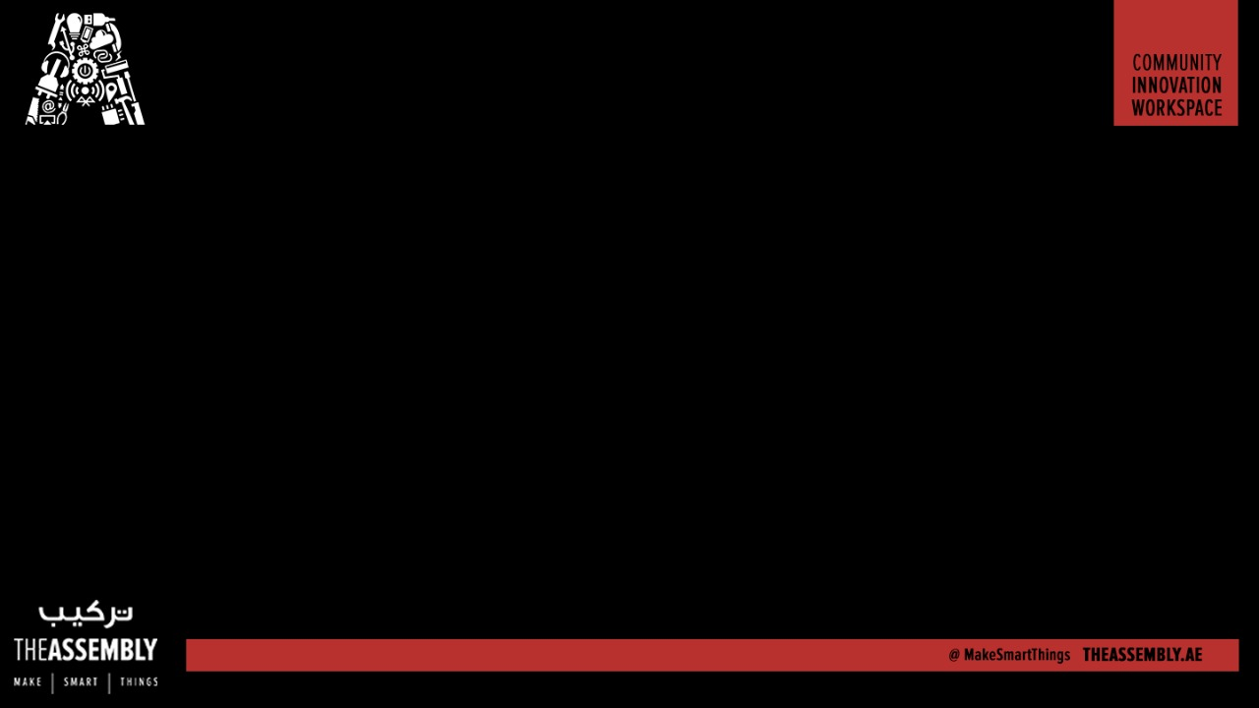
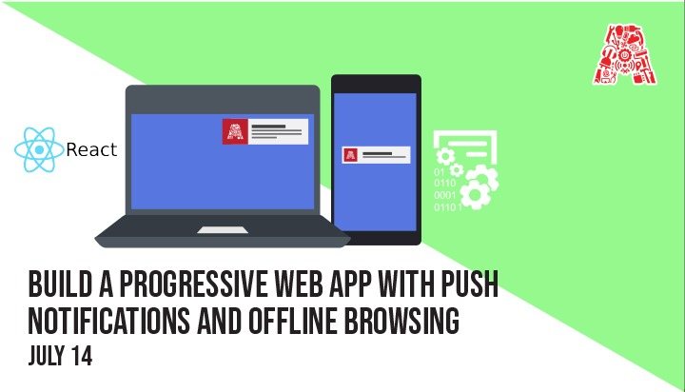
Wifi - In5-Tech [Code - WelcomeToIn5]

Slide 2
About the Assembly
A smart lab based out of In5 since Dec 2014
Over 200 free workshops done
ASSEMBLY: HACK - Embedded systems, iOT and hardware
ASSEMBLY: CODE - Software projects - APIs, frameworks, apps
Age range: 16-60 - students, professionals, entrepreneurs
Focus on smart technology and practical applications
Forum: members.theassembly.ae

Slide 3
TAG US ON SOCIAL MEDIA!
FACEBOOK - The Assembly (@MakeSmartThings)
TWITTER - @MakeSmartThings
INSTAGRAM - @MakeSmartThings
YOUTUBE - The Assembly

Slide 4
Overview
TOPICS:
Quick recap of Progressive Web Apps base concepts
Make a PWA ready React.JS Web App with Create-React-App
Service Worker concepts
Add push notifications to React.JS PWA
Add offline browsing to React.JS PWA

Slide 5
Getting started
Install: Visual Studio Code, Node.js
Github with all the code:
https://github.com/The-Assembly/PWA-Push
Pastebin:
https://pastebin.com/t4idcsMQ
Ask for help from the Assembly team if you get stuck with anything!

Slide 6
Progressive Web Applications
Concept - not one specific technology but combination of many
Goal - Replicate native mobile app user experience in web apps
PWAs should be -
https://developer.mozilla.org/en-US/Apps/Progressive/Advantages
DISCOVERABLE | PROGRESSIVE
INSTALLABLE | RE-ENGAGEABLE
LINKABLE | RESPONSIVE
NETWORK INDEPENDENT | SAFE

Slide 7
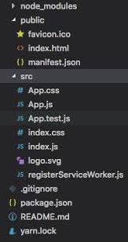
Create-React-App
Toolchain to create a single page React.JS web app
Installed from NPM at command line
Invoking from command line will generate scaffolding in working folder ========>
c:\> npm install -g create-react-app
c:\> create-react-app {working-folder}

Slide 8
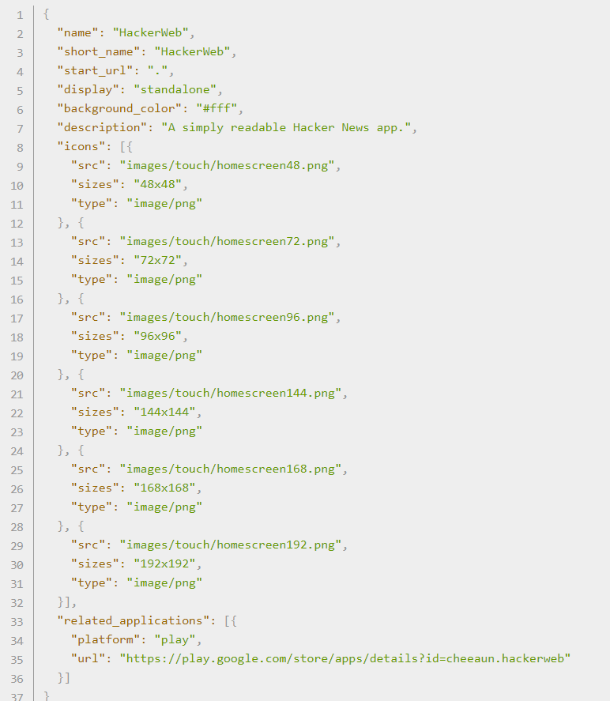
PWA - Web App Manifest
https://developer.mozilla.org/en-US/docs/Web/Manifest
https://developers.google.com/web/fundamentals/web-app-manifest/

Slide 9
Service Workers
A client-side proxy running in tanged with a website
Must be on HTTPS
Only one service worker at a time for each page
Runs on a separate thread

Slide 10
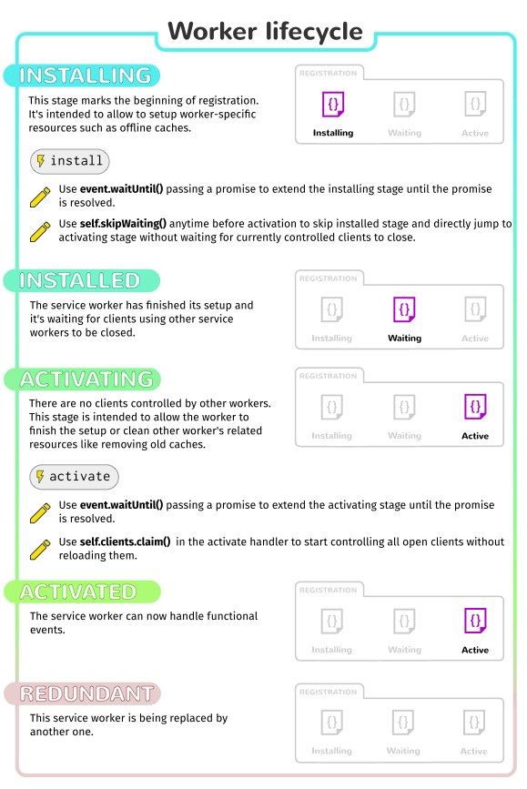
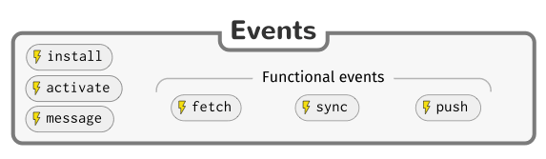
Service Worker Lifecycle + Events

Slide 11
PWA - Push Notifications

Slide 12
PWA - Push Notifications
Push notifications use web push API
Must be on HTTPS
Only one service worker at a time for each page
Runs on a separate thread
https://dev-quests.appspot.com/

Slide 13
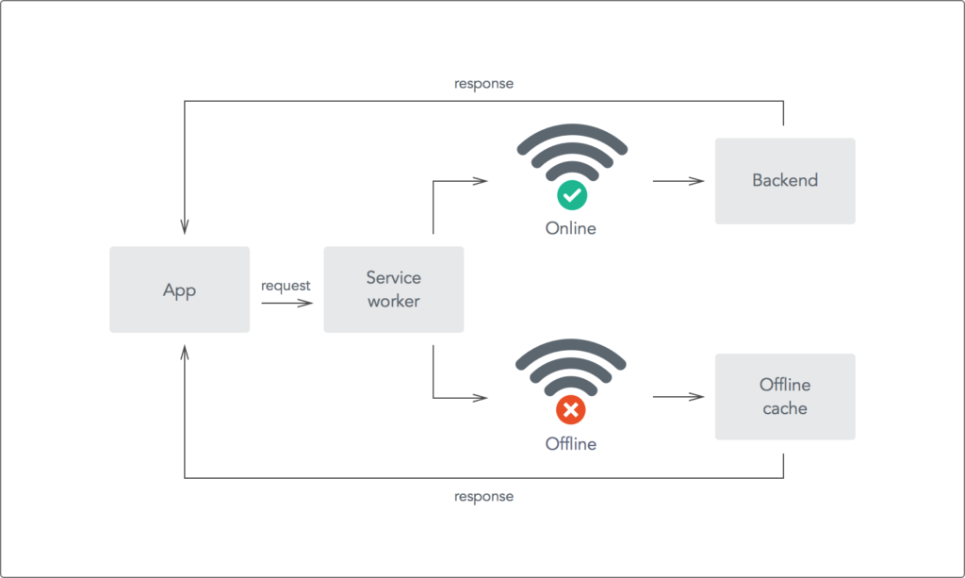
Service Worker - Offline Mode

